Slide 1

Intelligent Academic Planner
Daria Cook, Krystal Elliott, Xiaoyu Zhou
October 14th, 2016

Slide 2

Outline
Project Background
Business Background
Broader Impacts
Needs
Objectives
Development Process
Requirements
Use Cases & Sequence Diagrams
Exploratory Studies
System Architecture
Development Environment

Slide 3
Business Background
Project Sponsor: PSU Behrend CSSE Faculty
Cognitive Computing using Watson, an IBM supercomputer
Artificial Intelligence (AI): Self-learning systems that mimic human thought
Data mining
Pattern recognition
Natural language processing
Textual Analysis and a Numerical Scale of Performance using BlueMix
Analyse the information submitted by users to improve the knowledge base of the AI and deliver relevant feedback
Questions
Profiles
Quantitative analysis
How accurate is this response?
Notes:
Watson is a technology platform that uses natural language processing and machine learning to reveal insights from large amounts of unstructured data. Watson is a supercomputer that combines artificial intelligence (AI) and sophisticated analytical software for optimal performance as a “question answering” machine. The supercomputer is named for IBM's founder, Thomas J. Watson.

Slide 4

Broader Impacts
Advisors & Administrative Offices
Professors
Academic and Career Planning Center
Students
High School Juniors and Seniors
College Freshman and Sophomores
Universities
Educational
Society
Advisors
Administrative
Offices
Students
Universities & Educational Society
Business, H&SS
Penn State

Slide 5
Needs and Objectives
Training Watson using a specific domain of knowledge:
Penn State Behrend CSSE Majors Recommended courses Frequently Asked Questions (FAQ) Advisor information
Objective: Give students the ability to make an educated decision about which career to pursue based on their interests and strengths, and all that this entails, such as course recommendations and future salary expectations.
Notes:
Can we create a system to help with the enrollment process? We began modeling this sysem

Slide 6

Development Process
Project Selection
Team formation
Presentation & Report I
Presentation & Report II
Presentation & Report III
Presentation & Report IV
Aug
Sep
Oct
Dec
Feb
Apr
Sprint 0
Sprint 1 - 9
Agile Development Process (10 iterations )
Sprint 0 (On going)
Sprint 10
Initiate requirements
Priority
Functional
Non-functional
Setup system architecture
Initiate knowledge domain
Team formation
Initiate Documentation
Collaborate with advisers
Collecting training data
Complete functionality
Scalable application
Semi-automated
Publicly accessible
Notes:
Cal-vah-conti
Development Environment
Sequence diag
Accessable by anyone now, also accessable from next semester for students

Slide 7
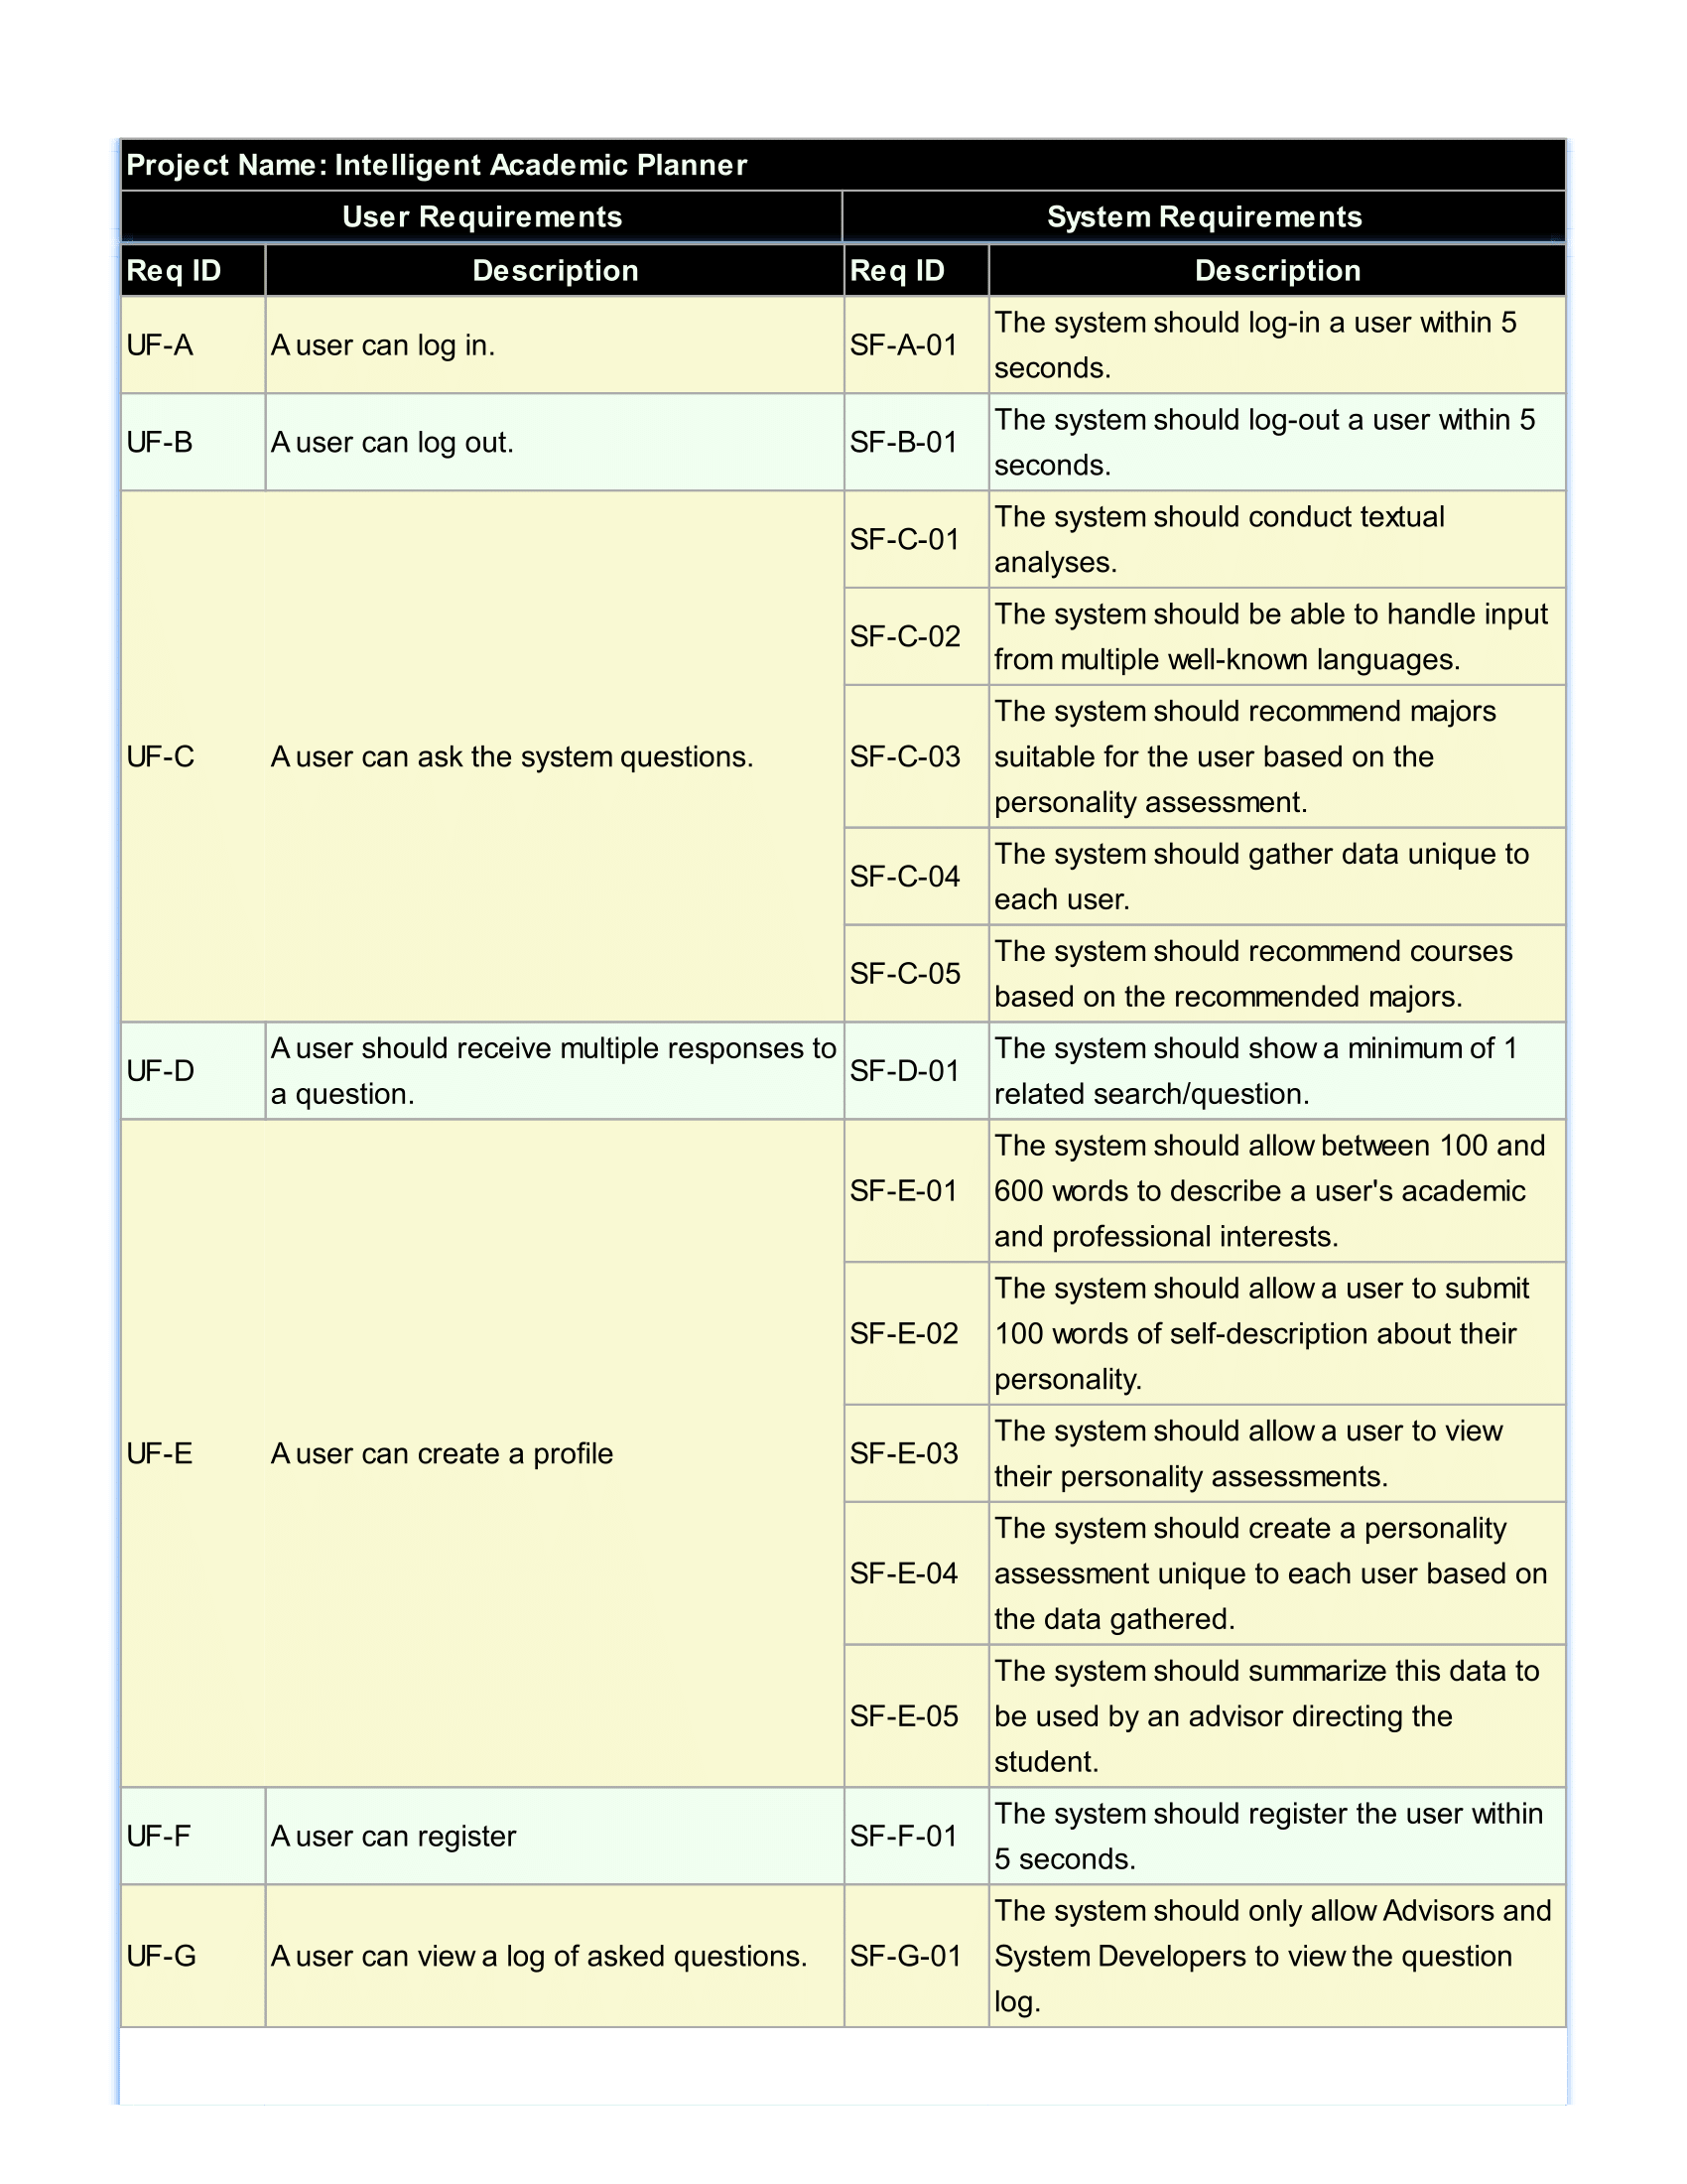
Requirements
Notes:
Basic Requirements: Login, Logout, Register
User has their own session to allow for assessments to be generated.
Profile is secure (only shows other what the user wants to show).
Key Requirements: Ask Question, Profile, Multiple Responses.
Conduct textual analysis
Main focus currently is to be able to answer questions about majors.
Both personality and general questions. (What is a software engineer? Or What kind of major would I like?)
Personality-answered questions are unique to the user, based on profile information.
Profile is there to contain data for personality analysis
100 words of self-description
100-600 words of academic and professional interest
Both assist with generating an answer related to the user.

Slide 8
Requirements
Notes:
Basic Requirements: Login, Logout, Register
User has their own session to allow for assessments to be generated.
Profile is secure (only shows other what the user wants to show).
Key Requirements: Ask Question, Profile, Multiple Responses.
Conduct textual analysis
Main focus currently is to be able to answer questions about majors.
Both personality and general questions. (What is a software engineer? Or What kind of major would I like?)
Personality-answered questions are unique to the user, based on profile information.
Profile is there to contain data for personality analysis
100 words of self-description
100-600 words of academic and professional interest
Both assist with generating an answer related to the user.

Slide 9
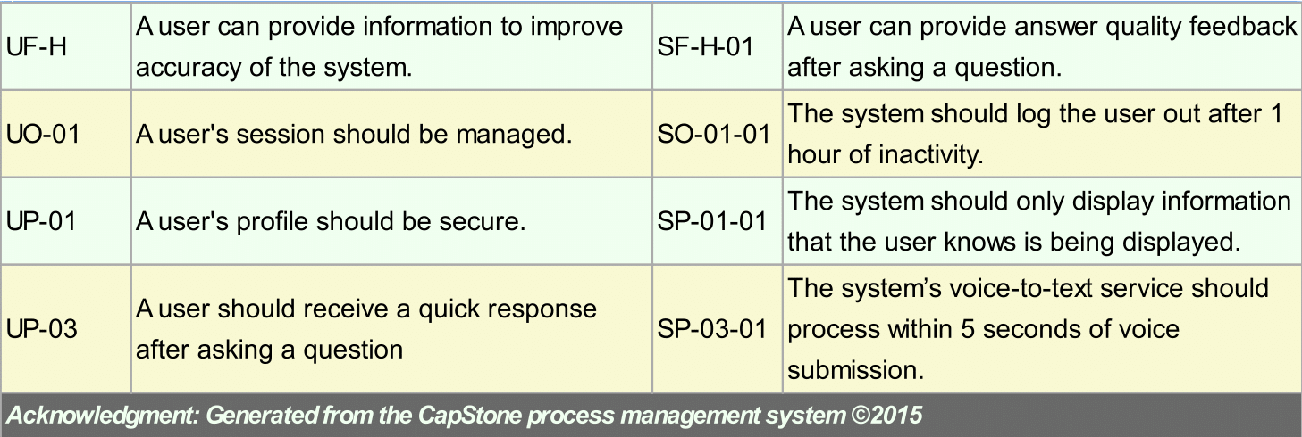
Requirements
Notes:
Basic Requirements: Login, Logout, Register
User has their own session to allow for assessments to be generated.
Profile is secure (only shows other what the user wants to show).
Key Requirements: Ask Question, Profile, Multiple Responses.
Conduct textual analysis
Main focus currently is to be able to answer questions about majors.
Both personality and general questions. (What is a software engineer? Or What kind of major would I like?)
Personality-answered questions are unique to the user, based on profile information.
Profile is there to contain data for personality analysis
100 words of self-description
100-600 words of academic and professional interest
Both assist with generating an answer related to the user.

Slide 10
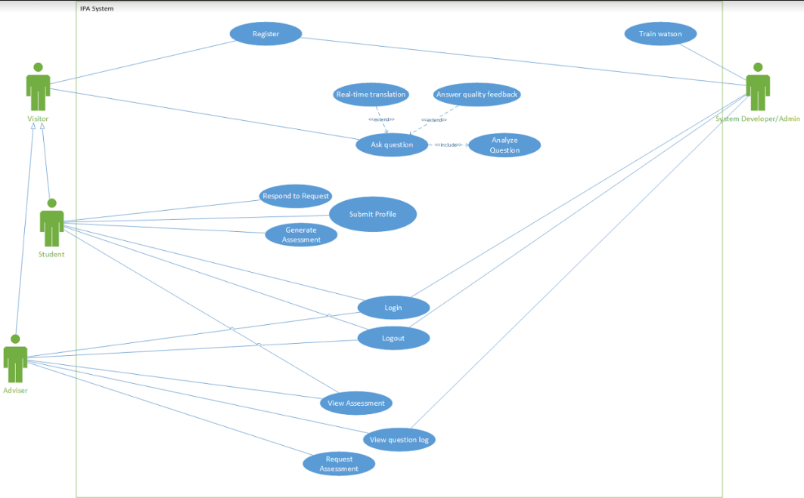
IAP System
Notes:
Quick overview of each use case and how the diagram’s notation works.

Slide 11
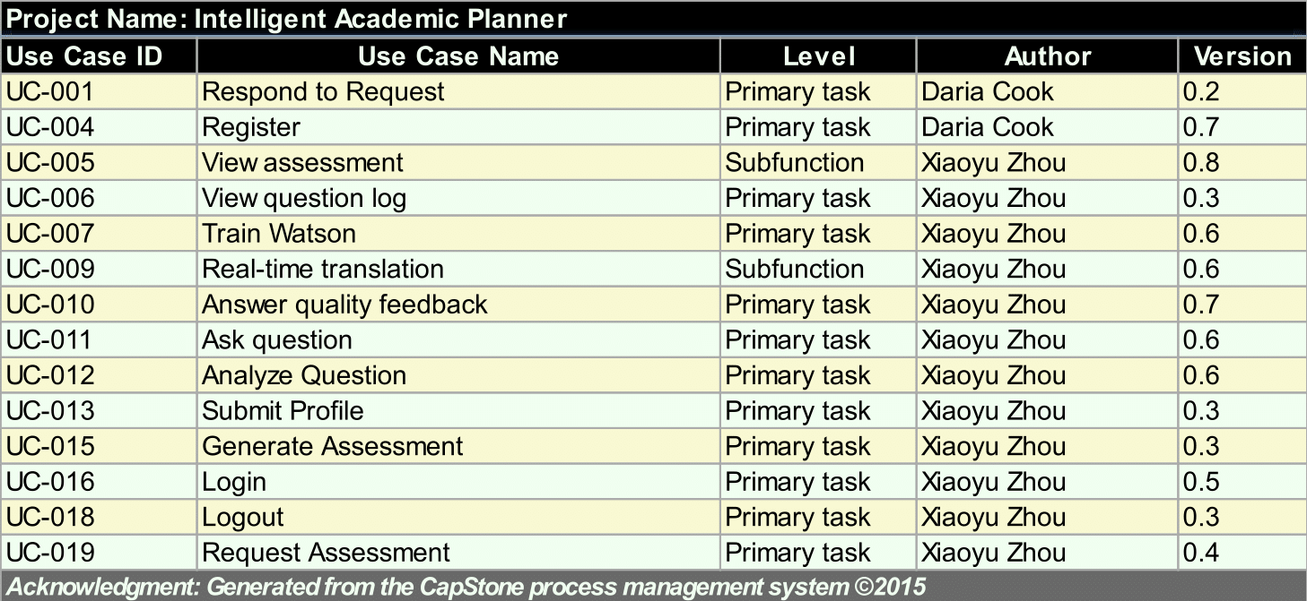
Use Cases
Notes:
15 Use cases in total.
Went over most in diagram, but going into detail on 2 important ones.

Slide 12
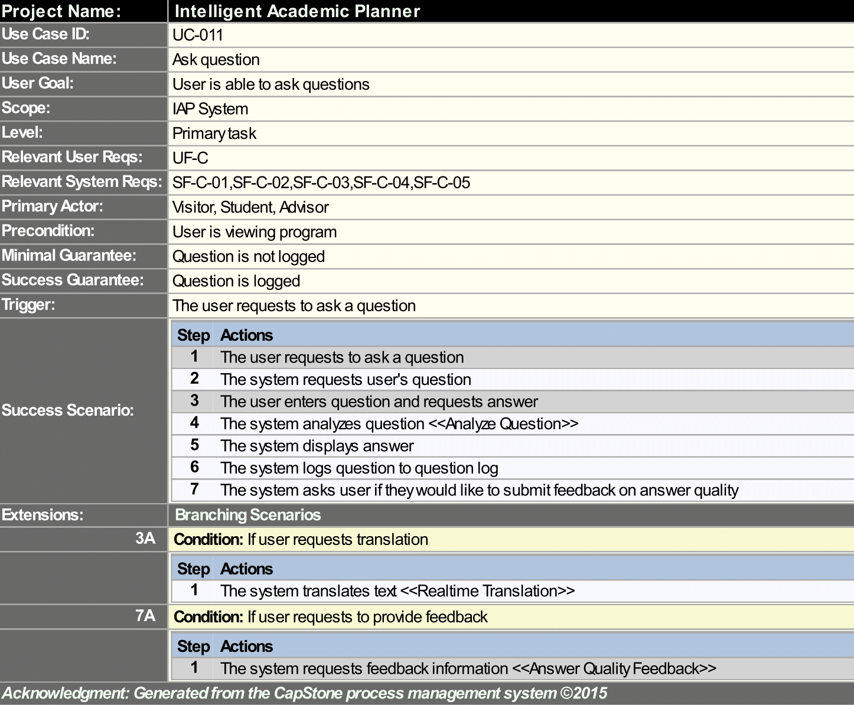
Notes:
Explain the process

Slide 13
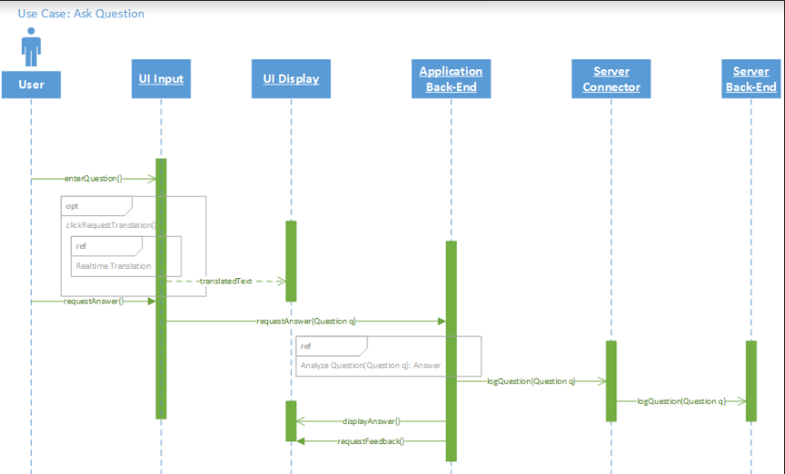
Notes:
Explain the process

Slide 14
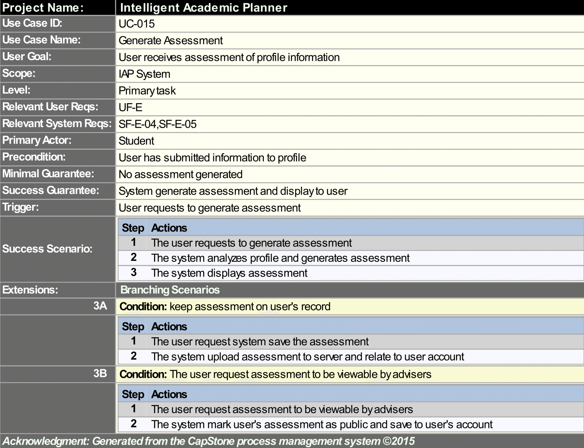
Notes:
Explain the process

Slide 15
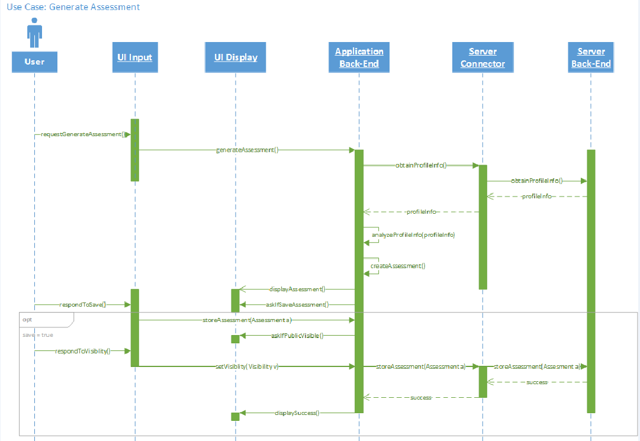
Notes:
Explain the process

Slide 16

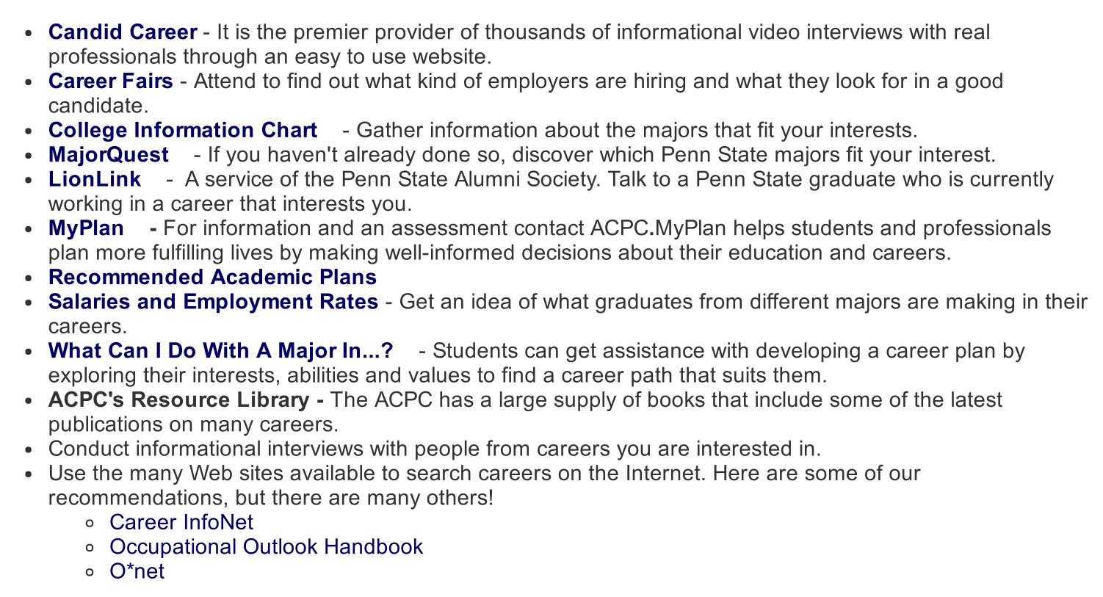

Exploratory Studies: Techniques
Academic and Career Planning Center
What questions/concerns did you
have when deciding on your school and major?
What classes should I take to prepare for Computer Science?

Slide 17









Exploratory Studies: Tools
...
IBM Watson
Natural
Natural Language Processing
...
Notes:
Watson: conversation, RnR, RT translation, voice to text, personality analysis, alchemy

Slide 18

Initial Consideration of System Architecture
User Event
User Interface
User Management
Question Analysis
Client Request
Update Display
Answering
Business logic layer
Assessment Report
Server computing
Update Client
Update Request
Render
Developer Utility
Data access layer
Query
Database
Notes:
Layered architecture
answering

Slide 19



Development Environment
Version control
Public access
Automatically deploy the master
Public access 24/7
Costless hosting and testing
Scale up flexibility
Update Master
Auto Deploy
Update Version
Statistic Monitoring
Notes:
git->expandable since its accessible by all group members
Statistic Monitoring

Slide 20



Notes:
Student retention
Happiness/Success
Save time and money

Slide 21
QUESTIONS?
Notes:
5 k, 4 a, 6 d

